Slide 1


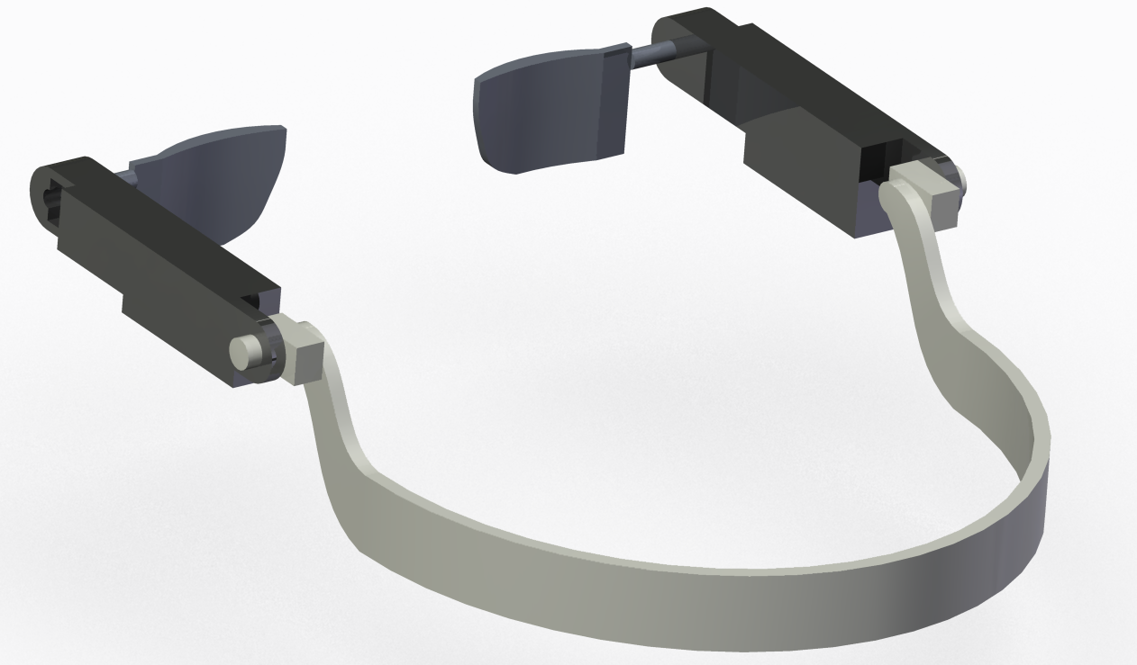
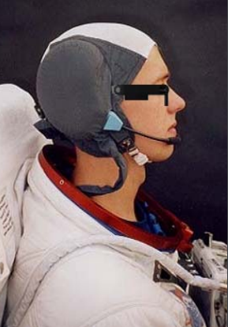
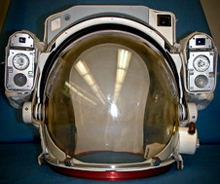
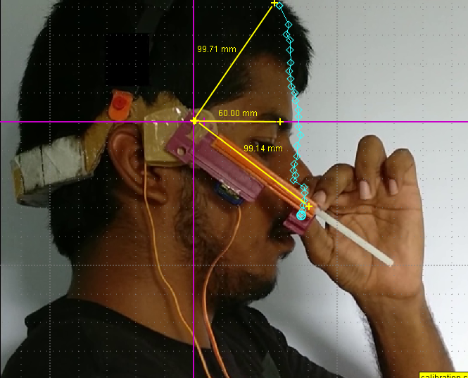
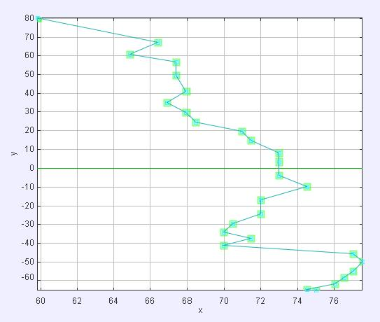
A Device for Removal of Ocular & Facial Irritants and Impurities inside
Spacesuit Helmets during Extravehicular Activities
2nd Cyber-Physical Systems Symposium 2018
Abhimanyu Shanbhag¹ ,Nikunj Parmar¹ & Ankur Pandya^{1,2}
¹Dept. of Mechanical Engineering , ^{1,2} Dept. of Electronics and Communication Engineering
Introduction
Astronauts inhabit spacesuits during extravehicular activities (EVAs) and also during the launch and return of the spacecraft. The following substances may interact with the astronauts’ eyes and facial region:
Contaminants like dust, spores, bacteria
Perspiration
Tears or moisture from the eye
Leaked water, cooling fluid
Anti-fog agent or other chemical substances
These cause debilitating pain, discomfort and temporary loss of vision in some cases. These substances cannot be cleaned off manually due to the inaccessible and sealed nature of the inside of a spacesuit helmet in operating condition.
Here, we introduce the concept of a device to be worn by astronauts inside their helmets, composed of sweeping actuated arms with absorbent and cleaning heads which would effectively remove the undesirable substances and provide relief, hence enabling the astronauts to operate unhindered and undistracted during spacesuit activities.
Delineation of the device
Supporting arrangement of the frame on the occipital bone and support for the servo mount on the periorbital area haven’t been shown in figure 1 for the sake of simplicity. The arrangement would vary based on contours of the astronaut’s occipital bone⁵.
Device Operation
Control switches - mounted on the HUT (Hard Upper Torso)².
Control signals processed by the DCM and relayed to the device via the electrical umbilical, which would also provide power^{1,2}.
The linear actuations and servo rotations would be automated to match the facial topography. Standby/OFF position - atop the head; outside the Astronaut’s field of vision.
Absorbent head
Servo Mount
Mass and Volume
Base volume with all strips: 6333mm³
Base mass: 3.19 g
Rack mass: 3.00 g
Rack holder mass: 0.640 g
Linear Actuator mass: 10.80 g
Servo motor mass: 10.20 g
Absorbent Head mass: 20 g
Miscellaneous mass: 1-2 g
Position of Mounting (in mm)
Servo motor: (0,0)
C.M. of Linear Actuator: (43, 18)
Effective C.M. of Base: (34.5, 14)
Point at which moment is acting on the Head: (102.50,0) in mm (While rod is fully extended)
etc
Effective C.M. of device: (47,8) in mm
Linear Actuator
Base
Frame
Servo
Figure 1. Device Parts
Figure 2. Side view of the device in action
Control System
Raspberry pi model 3 (For demonstration)
Display and Control Module(DCM) of space suit² (In Operating Condition)
Calculation
Torque = (distance from servo mount) * (weight of components)
The design is supposed to vary based on an astronaut’s facial dimensions. Hence, we can provide the exact torque required for servo motors by calculating the center of mass of the device.
EMU Helmet Assembly^{1,2}
Neck ring, Transparent shell
Purge Valve, Valsalva device
Vent pad and assembly
Visor Filters
Water bag, protein bar
External Lights and cameras
CCA – Snoopy cap, microphones, headsets
in mm
Results and Conclusions
The device performs the necessary functions required to remove moisture and contaminants which hinder an Astronaut during an EVA and it’s also compatible with the EMU. An EVA is a perilous environment in which even remote failures can have catastrophic consequences such as injury, drowning due to leaked water, loss of contact with the ISS etc⁴. Hence, the device could prove to be a life saver under such circumstances, while already being a useful addition to the Helmet Assembly.
Background
22 April 2001 - Astronaut Chris Hadfield experienced severe eye irritation during STS-100 spacewalk due to the anti-fog solution used to polish his spacesuit visor, temporarily blinding him and forcing him to vent oxygen into space³. Other astronauts experienced a similar problem on subsequent spacewalks⁴.
9 July 2013 – Luca Parmitano experienced a leak in his helmet that caused water to enter his eyes, nose, and mouth, increasing the possibility of drowning in space. The leak was caused by a blockage in the cooling system of his EMU⁴.
15 Jan 2016 – Tim Kopra and Tim Peake’s spacewalk was cut short due to a water leak in Kopra’s helmet.
Figure 3. Motion tracking of head mount
in mm
References:-
ILC Spacesuits, Dover- https://www.hq.nasa.gov/alsj/ILC-SpaceSuits-RevA.pdf
https://www.nasa.gov/pdf/188963main_Extravehicular_Mobility_Unit.pdf
Hadfield, Chris (2013). An Astronaut's Guide to Life on Earth: What Going to Space Taught Me About Ingenuity, Determination, and Being Prepared for Anything. New York City: Little, Brown and Company. pp. 86–96. ISBN 978-0-316-25301-7. LCCN 2013943519.
https://www.nasa.gov/sites/default/files/files/Suit_Water_Intrusion_Mishap_Investigation_Report.pdf
Prendergast P.M. (2013) Anatomy of the Face and Neck. In: Shiffman M., Di Giuseppe A. (eds) Cosmetic Surgery 29-45. Springer, Berlin, Heidelberg
Algorithm
Motion tracking of the Absorbent head – Tracker software or 3D scan
Tracked data is imported and analysed
PWM signals for Linear Actuator – based on positions tracked by Tracker at each point
PWM signals for Rotational motion – based on angles tracked by Tracker at each point
Abhimanyu Shanbhag
16bme001@nirmauni.ac.in
+91-7490895247
Nikunj Parmar
16bme003@nirmauni.ac.in
+91-9714963791
Dr. Ankur Pandya
ankur.pandya@nirmauni.ac.in
+91-7990879929
Idea Lab, Nirma University (idealab@nirmauni.ac.in)
Address: Sarkhej-Gandhinagar Highway, Gota, Chandlodiya, Ahmedabad, Gujarat 382481

